Slide 1






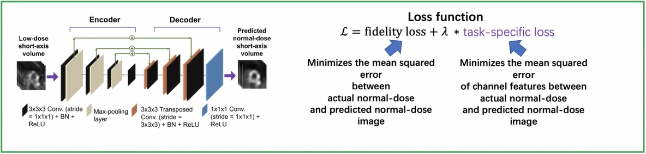




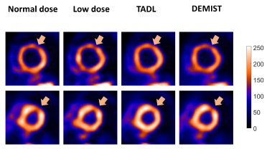
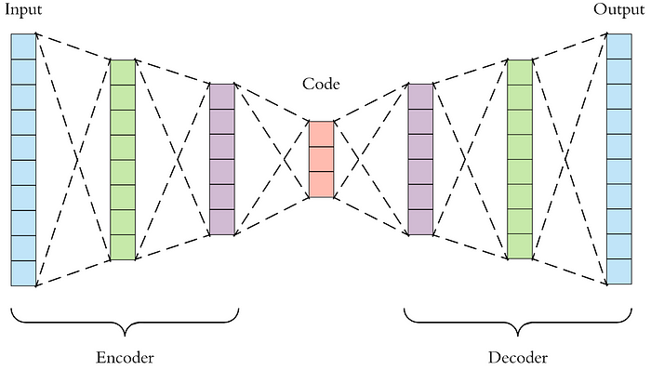




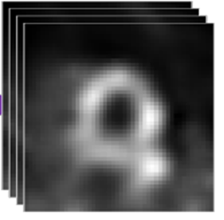


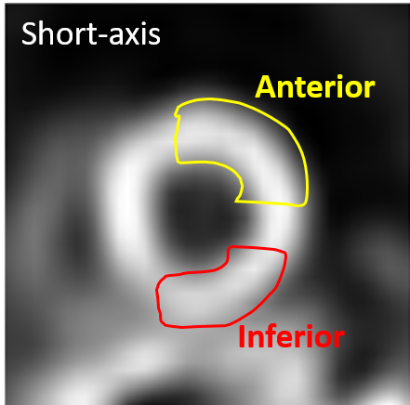
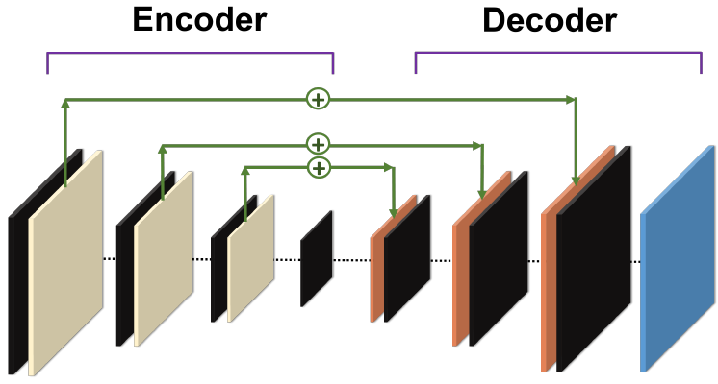

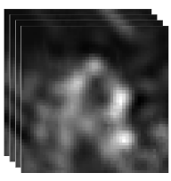







Auto-DEMIST: A task-specific denoising approach for myocardial perfusion SPECT
Zezhang Yang¹, Author 2¹, Author N^{1,2}
Computational Medical Imaging Group
Department of Electronic and System Engineering¹,Mallinckrodt Institute of Radiology²
Email: y.zezhang@wustl.edu Website: jhalab.wustl.edu
Introduction
Key Results
Technique yielded reliable performance
Outperformed commonly used semi-automated segmentation techniques
Generalizable across five scanners
Did not require substantial training data (even data from 25 patients yielded accurate results) Key Results
Technique yielded reliable performance
Outperformed commonly used semi-automated segmentation techniques
Generalizable across five scanners
Did not require substantial training data (even data from 25 patients yielded accurate results)
Processed normal-dose images
A task-specific deep-learning-based method (DEMIST) was proposed for low images denoising. To further explore the potential of DEMIST method, we conduct further experiments using clinic images.
Normal-dose images
Higher AUC means better performance. Although, AUC of auto-DEMIST is higher than the low-dose, it is hard to have higher AUC value than normal-dose.
MSE loss function
Auto DEMIST for denoising normal dose images
Auto DEMIST for denoising low dose images
Normal dose images
Normal dose images with no defect
Using LV-mask of related patient
MSE combine with task loss function
Randomly choose a coordinate from possible positions
Segmentation neural network
The autoencoder is a type of artificial neural network used to learn efficient coding of unlabeled data (unsupervised learning).
Low dose images
DEMIST
Predicted normal dose images
Results
Results
Generate test statistic using CHO
Normal-dose images
Processed normal-dose images
DEMIST
The autoencoders of both type of loss functions can reserve the defect signal and slightly improve the performance.
Low-dose image
Conclusions
It is hard to further improve the task performance from the low-dose images
Although, the auto-encoder with task specific loss has a better performance, even the auto-encoder with task specific loss can not have a distinguishable improvement
AutoDEMIST
Normal-dose image
MSE loss function
Acknowledgements
CHO with rotationally symmetric square frequency channels can emulate human observer performance. ROC analysis was performed on the obtained test statistics using the Metz-ROC software.
The autoencoder with skip connections will always give identical output and does not improve the tasks performance .
Financial support: NIBIB R21 EB024647 (Trailblazer award)
Computational support: NVIDIA GPU grant, CHPC
Thanks to our collaborators for the many exciting discussions and contributions!
Scan here for some references

